Slide 1
March Artwork & Activities
Hillside Traditional Academy

Slide 2
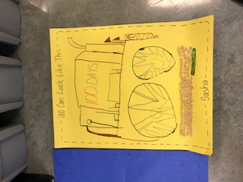
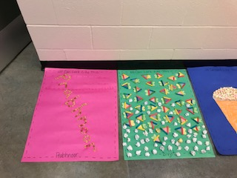
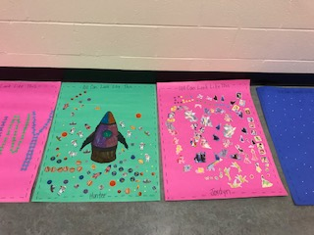
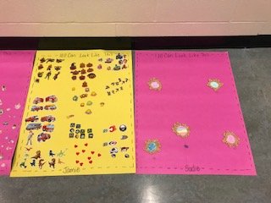
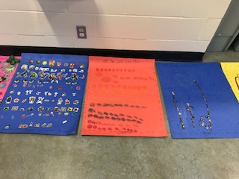
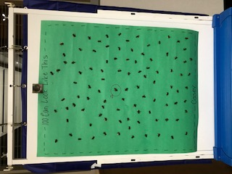
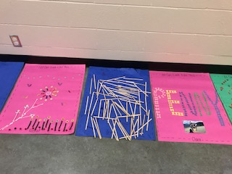
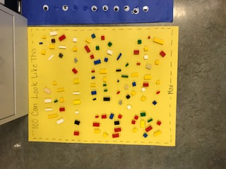
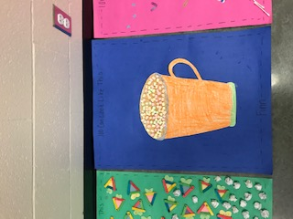
100 Days at School for Kindergarten Students

Slide 3
100 Days
What can you build with 100 Lego pieces?
Can you build a 100 piece puzzle?
Read books: 100 Theme

Slide 4
Can you build a 100 Day crown?
Can you build a 100 cup tower?

Slide 5
100 Exercises – Division 18

Slide 6
Division 17

Slide 7
Division 17

Slide 8
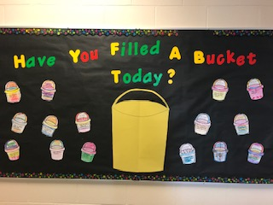
Division 18

Slide 9
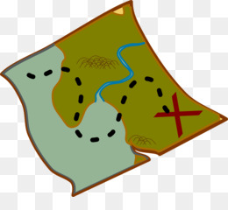
Division 12 – Mapping Skills

Slide 10
Division 18

Slide 11
Division 19

Slide 12
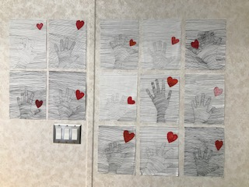
Division 4

Slide 13
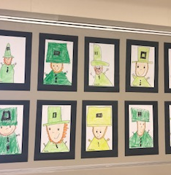
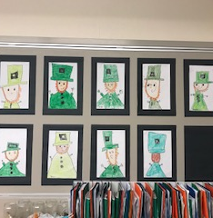
Leprechauns – Division 19

Slide 14
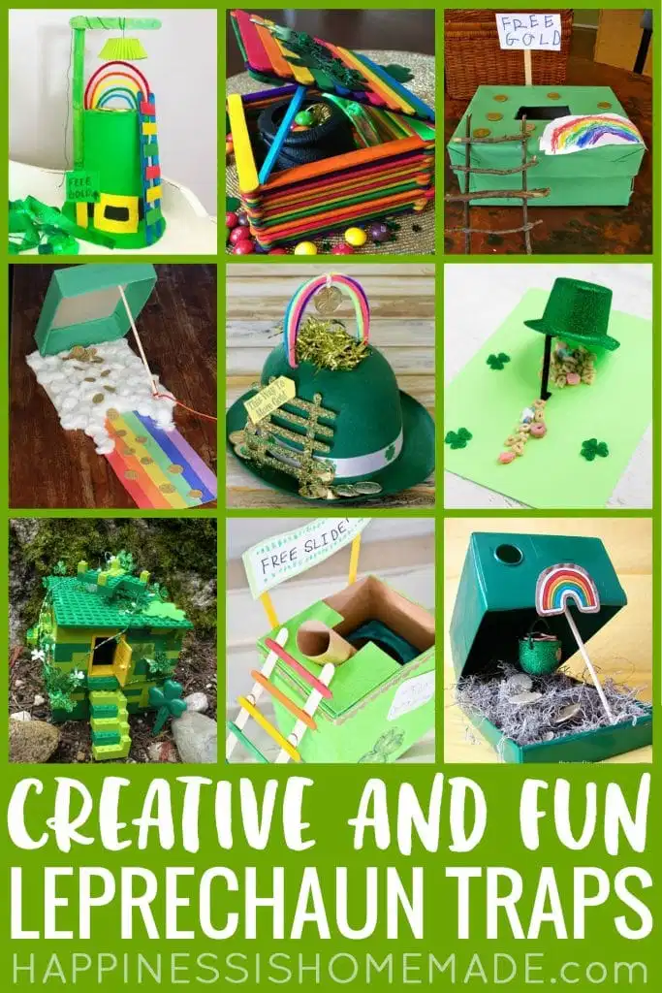
Leprechaun Traps by Division 19

Slide 15
Lucky visited Division 19

Slide 16
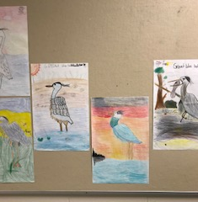
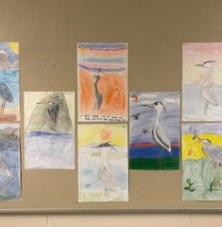
Blue Herons – Division 5

Slide 17
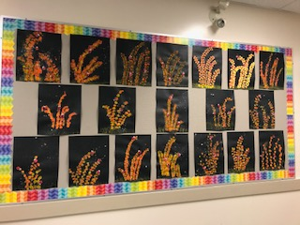
Division 13
Ladybugs on Pussywillows

Slide 18
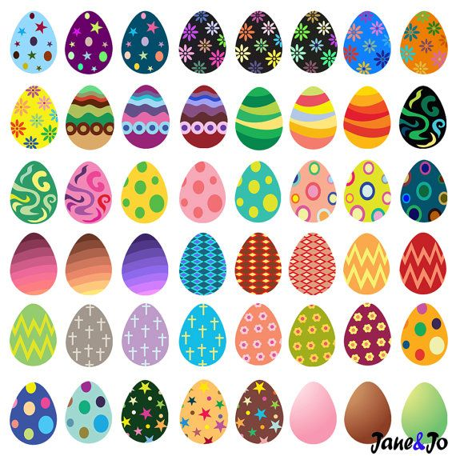
Division 3

